Slide 1
What’s in the SOC!

Slide 2
SOC at the Highest level
Threat intel (How to spot attacks)
SOC
Identified, minimized, and remediated incidents
Environment Data (Network and endpoint events)

Slide 3

Core SOC and Auxiliary Activities

Slide 4
Security Operation Maturity Model - SOMM
Level 0 – Incomplete
Level 1 – Initial
Level 2 - Managed
Level 3 - Defined
Level 4 - Measured
Level 5 - Optimizing

Slide 5
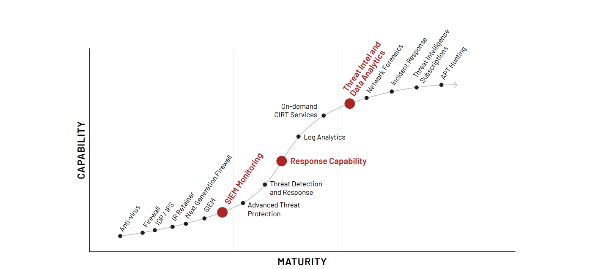
Cyber Defence Center Development Phases

Slide 6
SOC Functional Org Chart
SOC
Detection
Incident Response
Support
Assessment
Threat Intel
Triage and Analysis
Threat Hunting
Forensics
Engineering
Architecture
System Admin
Red Team
Pen. Testing
Vuln. Scanning

Slide 7
SOC Org Chart
SOC Director
Incident Lead
Analysis and Detection Lead
Incident Response Lead
Threat Intel Lead
Forensics Lead
Assessment Lead
Support Lead
T1 Analysts
T2 Analysts
T3 Analysts
IR Analysts
TI Analysts
Forensics Specialists
Red Team / Pen. Testing
Vuln. Scanning
Engineering
Architecture
System Admin

Slide 8

SOC Roles
Analysts – Tiers (Level 1, 2, 3)
Incident Leads
Engineer
Security Tester
Architects
System administrators
Manager
Legal Representatives

Slide 9
Tiered vs. Tierless SOC
SOC Lead
SOC Lead
Alert Escalation
Lead Analysts
Senior Analysts
Analysts
T3
T2
T2
Distributed workloads
T1
T1
T1
T1
Alerts

Slide 10
Tiered vs. Tierless Pros and Cons
Tiered
Pros
Repeatable Process
Clear separation of work tasks
Defined escalation path
More optimized use of time
Cons
Limits analyst growth
Analysts feel more like robots
Potential retention issues
Tierless
Pros
More varied and creative work
Uncapped analyst talent growth
Happier analysts
Cons
Requires a responsible team
Less defined process
Can be risker if expectations are not properly set

Slide 11

Steering Committee
Direct SOC towards the right activities
Ensure business alignment
Provide a two-way communication channel

Slide 12
SOC Tools and Technology
Collection and detection:
Foundational SOC capabilities
“Next-Gen” SOC capabilities and technologies
Triage, investigation, and response:
SIEM, Threat Intelligence Platforms
Incident Management Systems
Playbooks, Use Cases Databases, Software Repositories, SOC Knowledgebase

Slide 13
Events Collection
Event Focused
Application events,
Network traffics
System events
Alert Focused
IDS / IPS alerts
Email Alerts
Agent Based
Rely on agent software to collect.
Enable log filtering at the source.
Centralized management of log collections.
Agentless
No need to install additional agent software.
No central control.

Slide 14
Collection and Detection Technologies
Network
Network traffics
Next-gen firewalls
Network IDS / IPS
Endpoint
System Events – Authentication, process, application.
Host firewall
Anti-virus
HIDS
Application data
Web application logs
WAF logs
Database logs
Proxy logs
Cloud events
Audit Trails
NetFlow log
Cloud Inspection logs

Slide 15
What to look for in Networks
Layer 1,2
What is plugged in?
Layer 3
Source and destination talking.
Layer 4
What protocol being used?
Layer 7
Application specifics
Conversation metadata
Conversation Content
Network service logs
Proxy / web logs
DNS (external lookups)
DHCP
Lateral movement protocols – SSH, SMB, VNC, RDP
Device / Security Tools
NIDS/NIPS
Firewall service logs
Cloud & on-Prem – NetFlow
Packet Capture – cloud / on-prem

Slide 16





Open-Source network data collection tools

Slide 17
What to look for in Endpoints
Who is logging in?
What is running?
What services, autoruns and scheduled tasks are present?
IOC matches
Host events: OS, Sysmon, Auditd
Authentication success / failures
Process creation & arguments
Services, autoruns & scheduled tasks
Security Tools
Anti-virus / EDR
HIDS / HIPS
Host firewall (Heavily filtered)

Slide 18
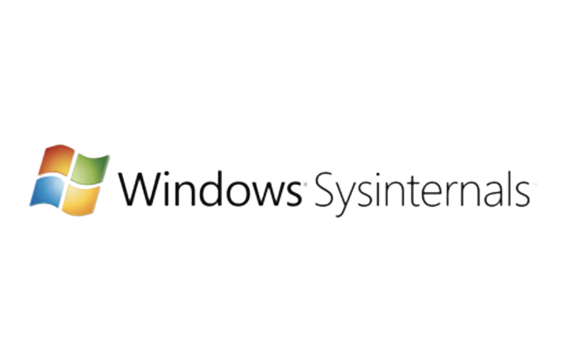



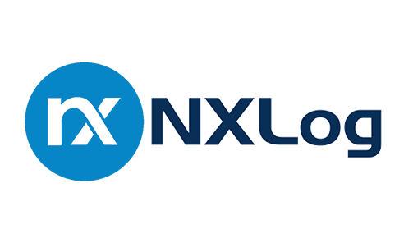


Open-Source Host data collection tools

Slide 19
Analyst Core Toolsets
Security Information and Event management (SIEM)
Threat Intelligence Platforms (TIP)
Incident Management Systems (IMS)
Use Case Databases
Information Knowledgebases

Slide 20

SIEM One of the most important SOC tools!

Slide 21



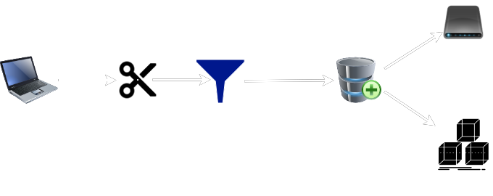
SIEM Capabilities and duties
Centralized log storage
Data parsing, correlation, and enrichment
Indexing for quick search
Detection and alerting
Visualization and reporting

Slide 22
Threat Intelligence Platform
IOCs to watch for in the environment
Context for those IOCs (timeframe, use, campaign)
The threat actors behind them and their goals, TTPs
Analyst
Analysis
SIEM
Threat Intelligence Platform
External Info
Incident Management System
Indicator Lookup, Threat Context and Info

Slide 23
Incident Management System
Ticketing and Tracking System
Integrated with threat intel and automation platforms
SIEM
Threat Intelligence Platform
Closed cases
Alerts
Metrics
IOCS
Automated actions and context
Threat Intelligence Platform
SOAR

Slide 24
Playbooks
Things should be done before escalation / closure as false positive.
May be mandatory or optional.
Manual investigative steps handled by analysts.
Automatable actions handled by SOAR.
Malicious email received
Block all URLs
Delete from inboxes
Check proxy log for clicks
Reset password for victims

Slide 25
Next-gen SOC Capabilities / Technologies
Threat Hunting
Proactive hunting of compromise
Endpoint detection and response (EDR)
Automation
Security Orchestration Automation and Response (SOAR)
In-house developed scripts
Malware sandbox

Slide 26
Advanced SOC Capabilities / Technologies
User Entity Behavior Analysis (UEBA)
Artificial Intelligence & Machine Learning analytics (AI/ML)
Data lakes (big data) analytics and processing

Slide 27
SOC as a Platform
Governance for evolving capabilities and focus
Minimizes reactive solutions
Encourages continuous growth and innovation
Analysis of Alternatives
Opportunity
Analysis criteria
Alternatives
Features & functionality
Results

Slide 28
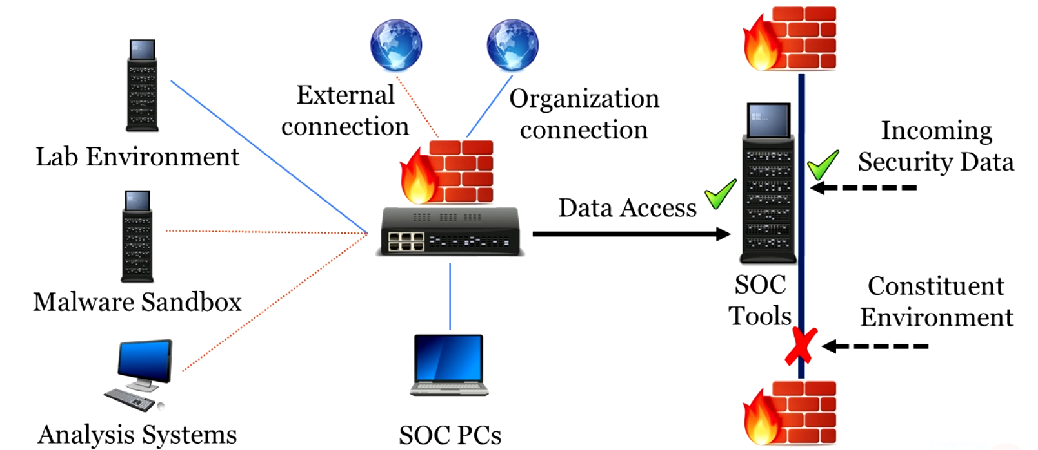
SOC Private Environment

Slide 29
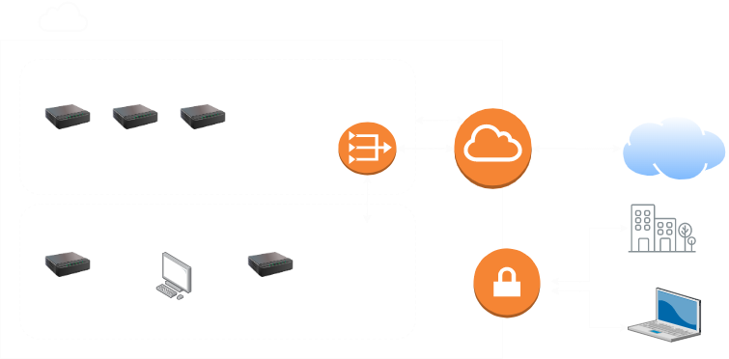
SOC Private Environment on AWS

Slide 30

Modern Defense Mindset
Presumption of Compromise
Detection-Oriented Defense
Proactive Detection: Threat Hunting
Post-Exploitation Focus
Response-Driven Teams
Risk-Informed Strategy

Slide 31
Think like a hacker!

Slide 32
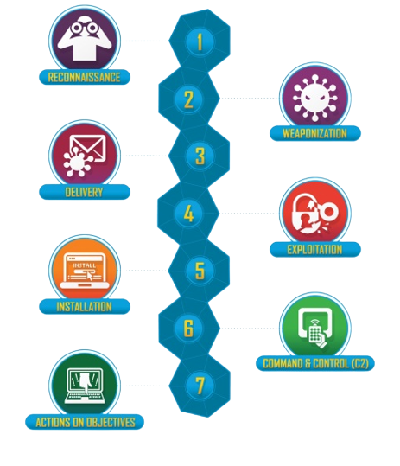
Cyber Kill Chain
Meant to model APTs ONLY.
Often misused by applying to all alerts.

Slide 33
Defense in Depth
Parameter
To make the threat actor job difficult.
Integrating multiple solutions to disrupt threat actor objectives.
Data
Network
Defense in Depth
User
Host
Application

Slide 34
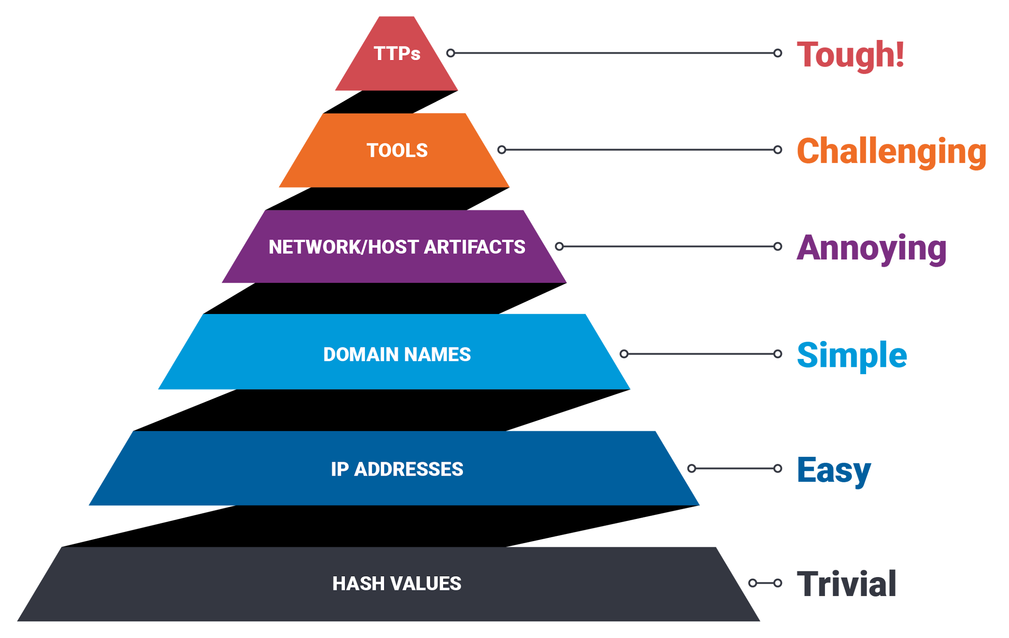
The pyramid of Pain
The tops have longer relevance, broad coverage, lower fidelity.
The bottoms have shorter relevance, specific coverage, higher fidelity.

Slide 35
Collection and Log Management
The heart of SOC

Slide 36
Fundamental Concepts:
Defining goals
What to collect
How to collect logs and data
Key data sources
Collection efficiency and cost and practical issues

Slide 37
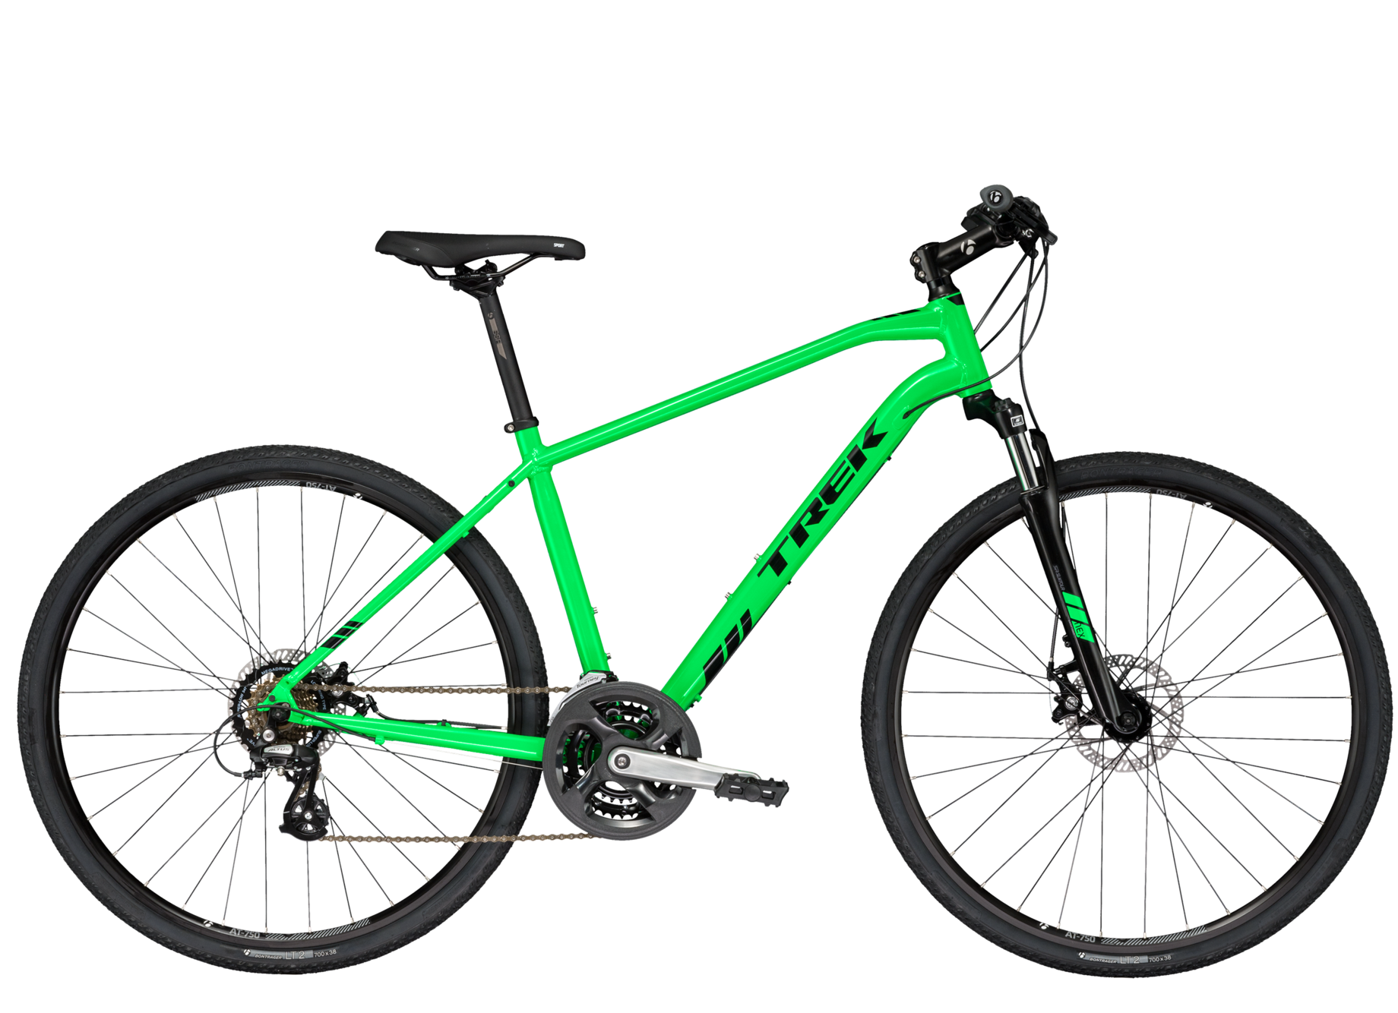

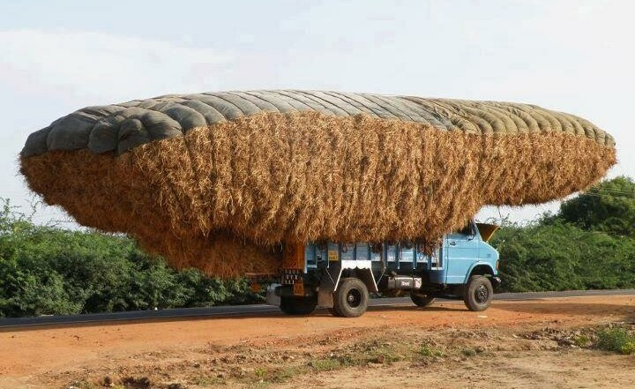
Tactical Log Collection
Collect everything, just in case?
Only collect what we know we need?
Collect many things, assess for noise, adjust frequently
Too little
Work most of the time
Too much
Notes:
Collection goals:
- IOC based matching
- Advanced attack detection / threat hunting
- Audit?
- Compliance?
SIEM charge based on rate / volume
Tactical collection = cost efficiecy

Slide 38
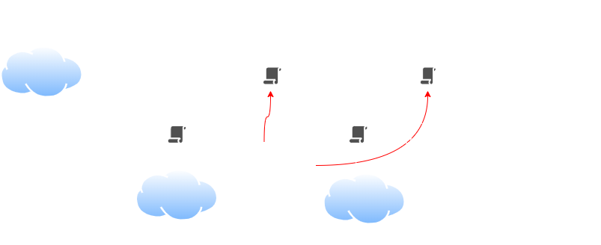
Ideal Collection System

Slide 39

Realistic Collection System
Notes:
Agent vs Agentless collection

Slide 40
Audit Policy Flexibility
Exploits are unpredictable.
To detect, may require collecting of new events.
Keys to success:
Centrally managed log agents, collection policy
Fast approval process for changes
Speed of change deployment

Slide 41
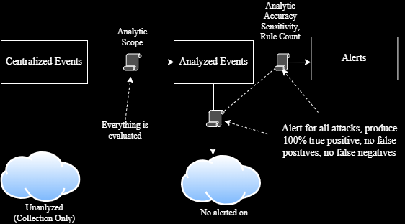
Ideal Detection system

Slide 42

Detection Decision
Pros
Tolerable queue
Happy analysts
No alert fatigue
Cons
High potential for false negatives
Pros
Unlikely to miss attacks
Cons
False positives
Burnout, alert Fatigue
Alert Volume
Zero False Positive
Zero False Negative

Slide 43
Detection Engineering Concepts
Inputs
Threat model
Intelligence
Visibility
Process varies depending on the SOC maturity and detection pipeline.
Involve data sources, event pipelines, correlation and enrichment, and detection mechanisms.
Goal is complete data sources, simple but robust pipeline, flexible detections, and as much correlation, enrichment, and automation as possible.

Slide 44

Blue Team Improvement: The way it used to be
Every SOC is an island:
Everyone gathers threat intel on their own
Everyone writes their own analytics
Everyone invents their own analysis techniques
Clearly this is super inefficient

Slide 45
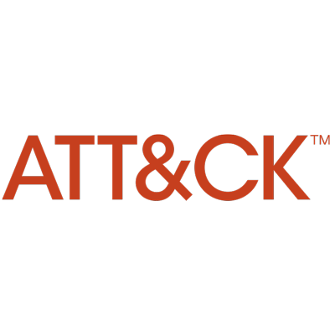



Blue Team Improvement: The way of the future
Standardization of attack descriptions | Standardization of file, packet & log analytics | Capturing complex analysis
Codified attack tactics, techniques, and groups that use them. | Generic detection languages for files, network traffic, and now logs! | Repeatable complex analysis that’s easy to share.

Slide 46
Suggested Fields to Track
Objective
Lifecycle Stage
Priority
Author
Analysis steps (playbook)
Changes over time
Data Sources
Category / Type
Known false positives
False negatives / blind spots
Validation techniques
Article references
Analytic Logic
Framework alignment (MIRTE, Kill Chain)

Slide 47
Threat Hunting Process Overview
Formulate Hypothesis
What would our adversaries do?
Define Evidence
What evidence would this attack leave?
Data-Source Identification
Which data sources are available in our environment that would identify this evidence?
Gather and examine the data
Does it show compromise?
Respond to findings
Invoke incident response if needed
Analytic and protection improvement
Close the loop!

Slide 48
Defensible Network Architecture: The Return
Monitored
Inventoried
Controlled
Claimed
Minimized
Assessed
Current
Measured : Security team measures progress against previous status.

Slide 49
Incident Response Go Time
Assign the incident handler / lead
Collect data from key NSM / CSM data sources
Understand who owns the asset and what it does
Identify any compliance and/or safety issues
Categorize the incident
Begin remote live-box investigation if required

Slide 50
IR : Evaluating Key Data Sources
Need intentional investigation plan.
Don’t just dive in aimlessly – time is valuable
Questions:
What specific question are you trying to answer?
What data do you need to answer that question?
How/where can you get that data?
What does the data tell you?
Brainlessly typing around the keyboard will not make you analyst!
Notes:
Be ready to perform additional data capture and analysis when required – too late to think about these capabilities when an incident has occured

Slide 51



IR Tools
Mandiant Redline
Kansa
KAPE

Slide 52
SOC Challenges
Shortage of cybersecurity skills
Too many alerts
Operation overhead
Maintenance
GROWTH

Slide 53
Infinite Strategy
Continuing to play the game requires A-players.
Training and retaining A-players requires a great place to work.
Notes:
Employee engagement
Job satisfaction and retention
Challenging employees to grow, providing training
Giving analysts space for freedom, flexibility, and creativity
What works in the long term and not just now

Slide 54
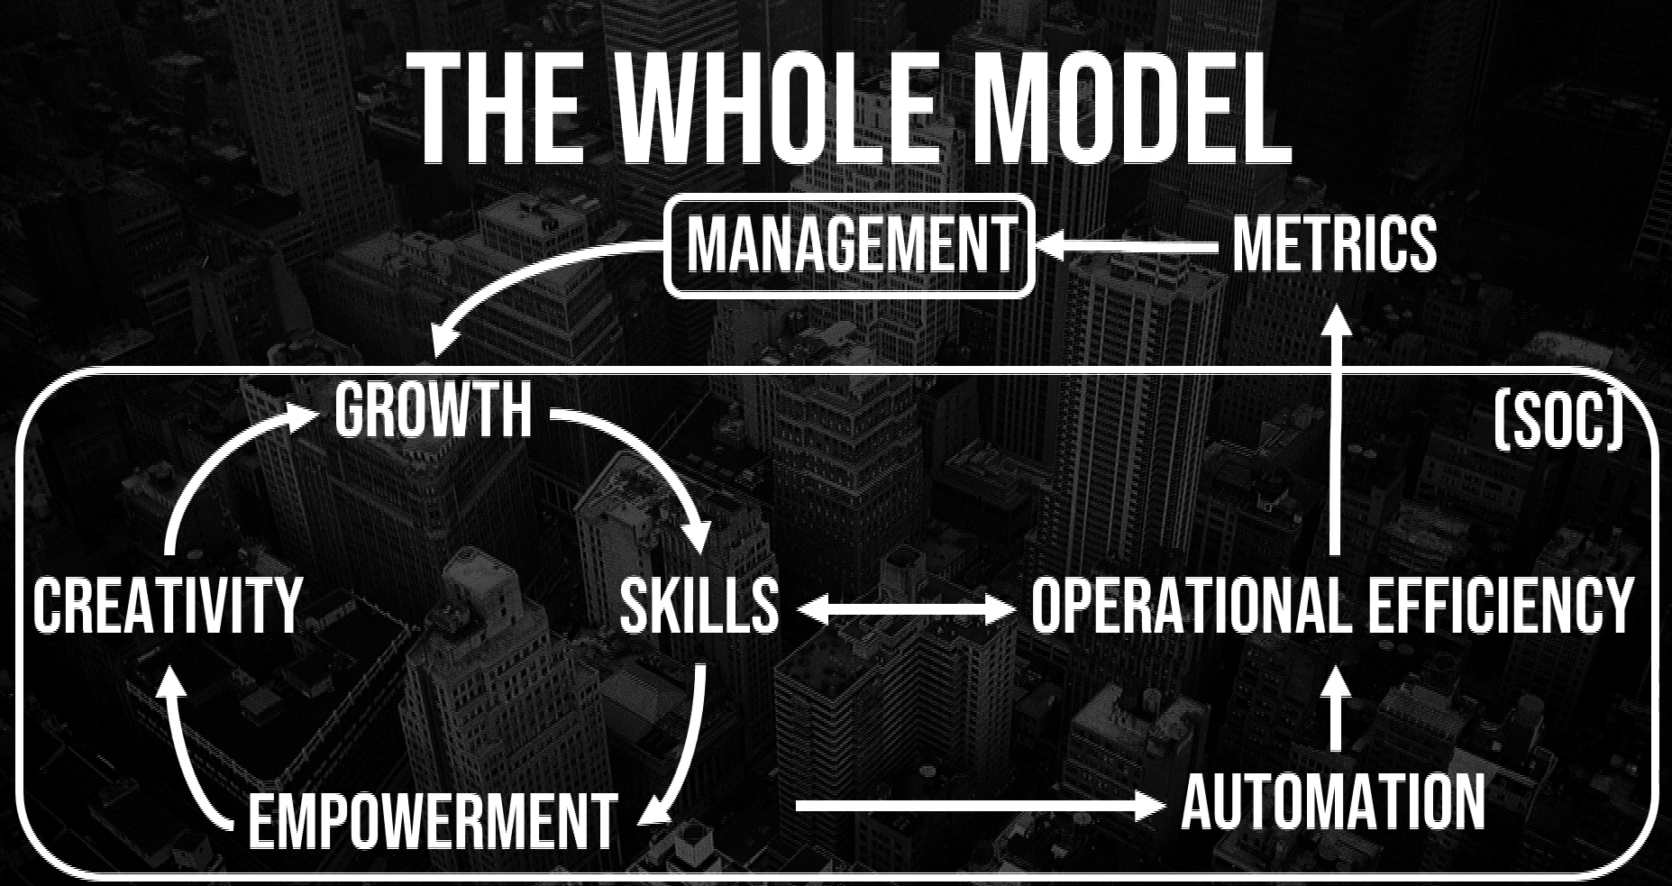

Slide 55
Training Plan
Immediate | Intermediate | Transitional
SEC450: Blue Team Fundamentals-Security Operations and Analysis (GSOC) SEC401: Security Essentials (GSEC) | SEC511: Continuous Monitoring and Security Operations (GMON) SEC586: Blue Team Ops-Defensive PowerShell SEC504: Hacker Tools, Techniques, Exploits, and Incident Handling (GCIH) SEC503: Intrusion Detection In-Depth (GCIA) SEC595: Applied Data Science FOR610: Reverse Engineering Malware (GREM) | SEC555: SIEM with Tactical Analytics SEC530: Defensible Security Architecture FOR500: Windows Forensic Analysis FOR578: Cyber Threat Intelligence MGT512: Security Leadership Essentials for Managers

